Slide 1
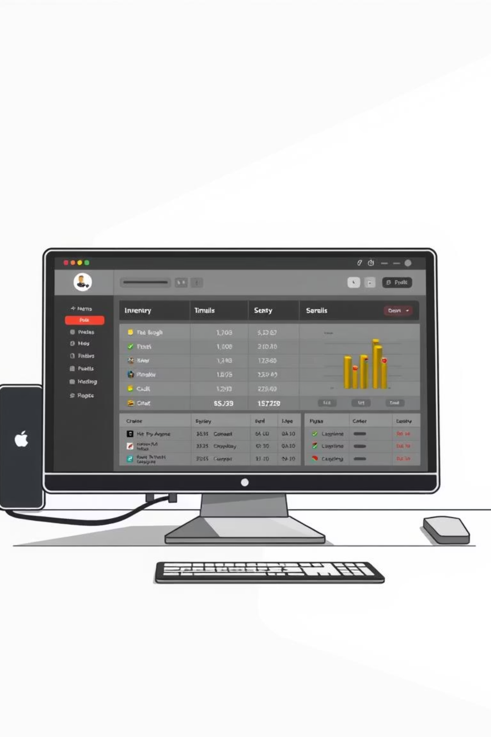
Product Inventory Manager
An efficient solution for small businesses, developed by Ahmad Hassan, Zohaib Hassan, and Naveed Tariq.

Slide 2





Project Overview
Desktop Application
Database Management
Python with Tkinter GUI
SQL Server backend
Streamlined Inventory
Real-time Interaction
Add, update, delete, view products
Intuitive GUI with live data
Designed for small businesses to manage product inventories efficiently.

Slide 3
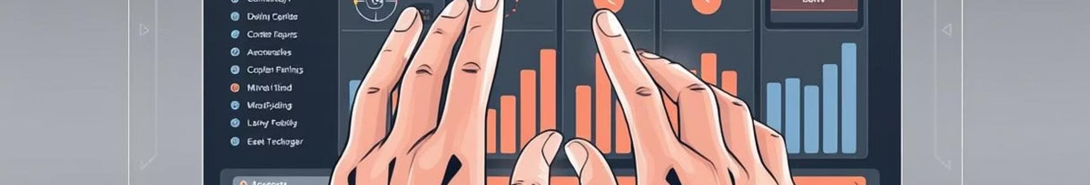
Core Features at a Glance
1
2
Add Product
Update Product
Easily input new products with name and price.
Modify details of existing inventory items.
3
4
Delete Product
View Products
Remove products from your inventory.
Real-time table display of all products.

Slide 4
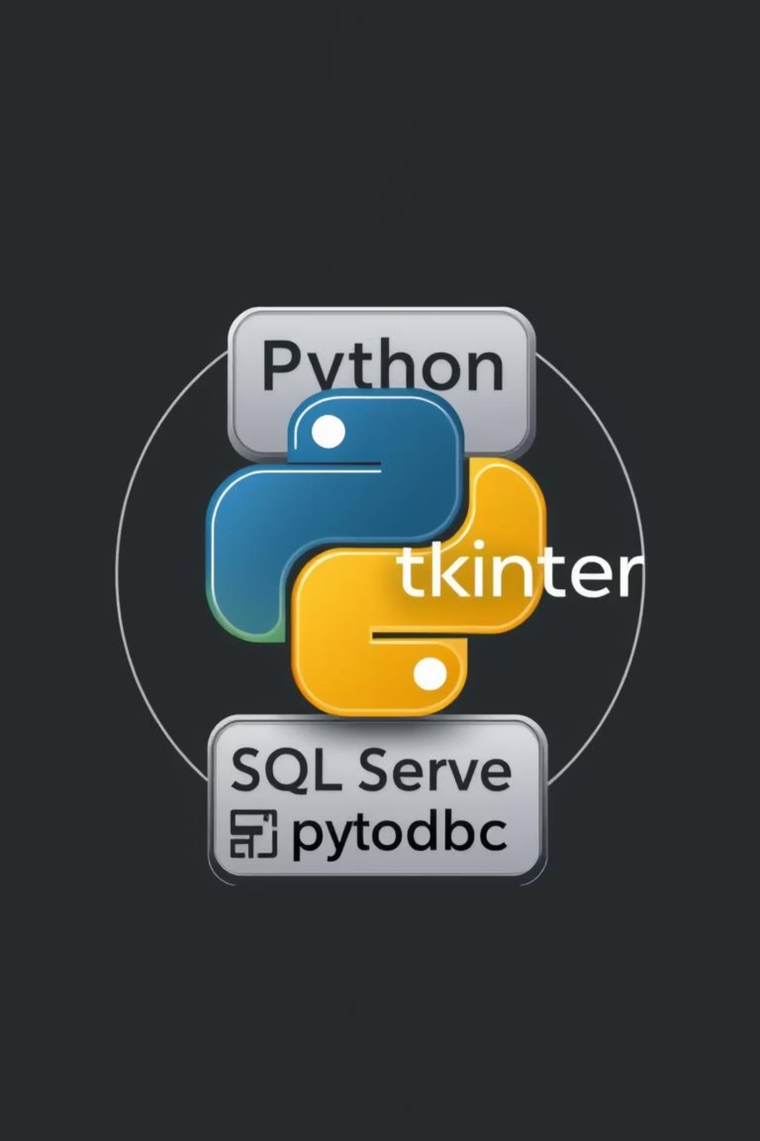
Technology Stack
Python 3.x
Primary programming language
Tkinter
GUI framework for interactive interface
Microsoft SQL Server
Robust database management system
pyodbc
Database connector for Python
Compatible with Windows operating systems.

Slide 5
Database Design
A single, optimized table for product details ensures simplicity and performance.
Column Name
Data Type
Description
Id
INT (Primary Key, Identity)
Unique Product ID
Name
NVARCHAR (100)
Name of the product
Price
FLOAT
Price of the product
SQL Script to Create Table:
CREATE TABLE products ( id INT IDENTITY (1,1) PRIMARY KEY, name NVARCHAR (100) NOT NULL, price FLOAT NOT NULL );

Slide 6





Application Workflow: User Actions
Launch Application
GUI displays product table & input fields.
Add Product
Enter name & price, click 'Add'.
Update Product
Select, modify, click 'Update'.
Delete Product
Select a product, click 'Delete'.
View Products
Scrollable, real-time updated table.

Slide 7

Use Case Diagram
The system supports a clear set of interactions between the user and the inventory manager.
Add Product
Register a new inventory item
Update Product
Modify existing item details
User
Actor interacting with inventory manager
Delete Product
Remove an item from inventory
View Products
Browse current inventory list

Slide 8
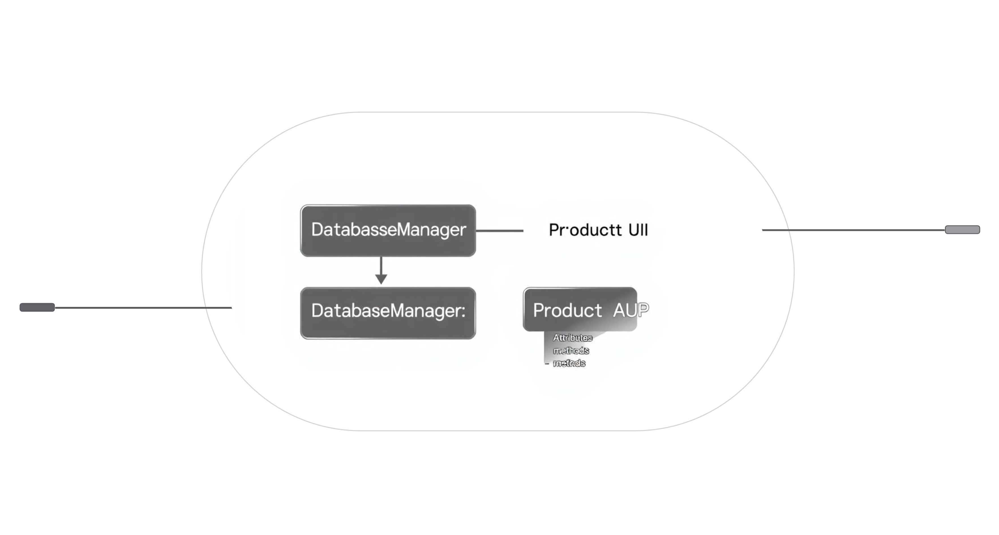
Class Diagram: System Architecture
Key components and their relationships within the application.
ProductApp (GUI)
root, treeview, inputs; load_products(), on_add(), on_update(), on_delete(), select_row()
DatabaseManager
server, database; connect(), fetch_products(), add_product(), update_product(), delete_product()

Slide 9

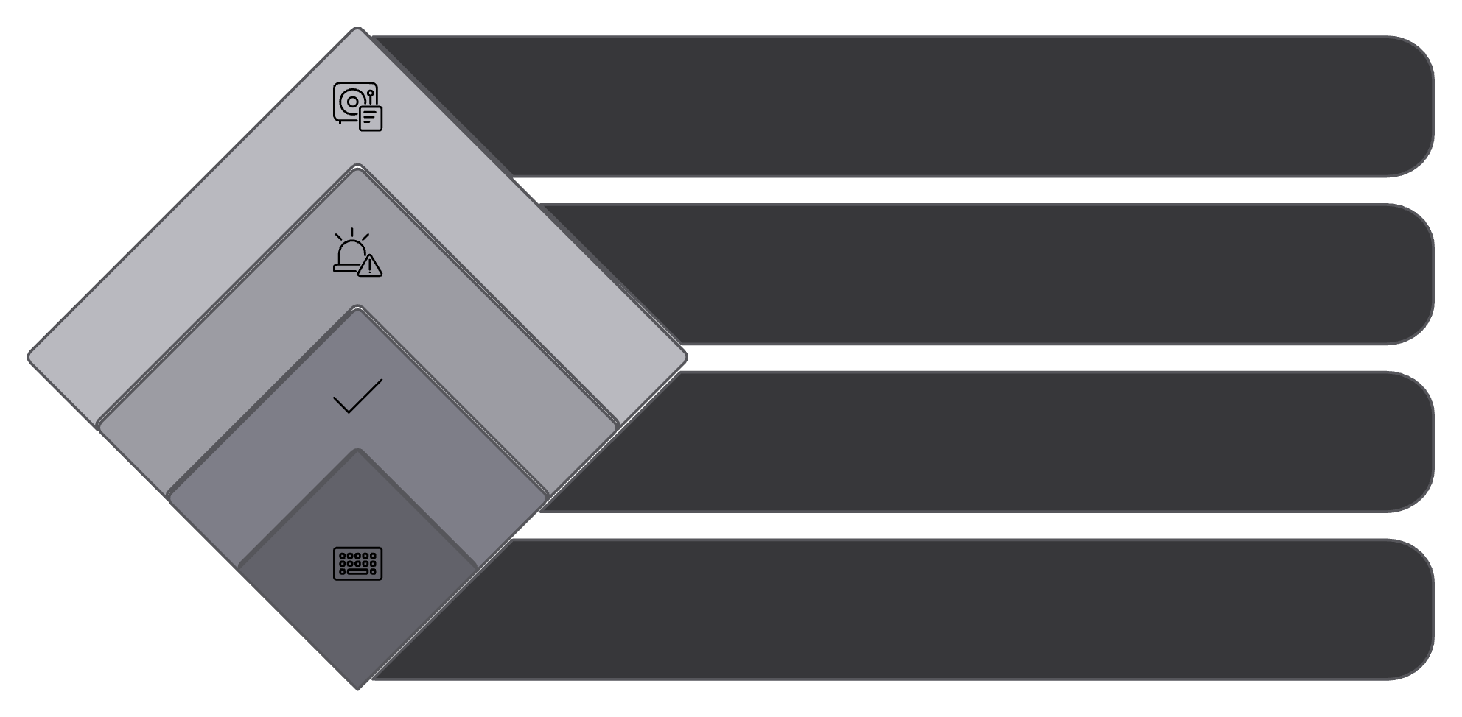
Activity Diagram: Adding a Product
Step-by-step process from user input to database update.
Insert & Refresh
Add to DB and update view
Show Error
Display validation message
Validate Inputs
Check required fields
Enter Product
Name and price input

Slide 10

Future Enhancements & Conclusion
Planned Features
Summary
Search functionality
A robust, user-friendly application simplifying inventory management, effectively integrating Python, Tkinter, and SQL Server.
Category-wise management
Export to Excel/PDF
User authentication
This project demonstrates practical development and efficient database interaction.

